Slide 1




PAS Software Factory
PAS7: Sprint 14 Kick-Off
Oversight
August 8, 2015

Slide 2
Contents
1.0 RTC Scope Detail: Sprint 14 and PAS7 Overall | 3
2.0 Scope Control | 5
3.0 Sprint Parameters | 6
4.0 Key Checkpoints for the Sprint | 7
5.0 Integrations Scope | 8
6.0 Stabilization Parameters | 9
7.0 Impacts to Schedule: Holidays and EM Schedule | 10
Appendix: Detailed Scope List | 12

Slide 3
1.0 RTC Scope Detail: Sprint
1.1 Sprint 14
Release Allocation | Work Item | # Scope Items | Story Points
CA Auto Choice | WI0022 | 85 | 378.5
CA Select Changes - DOI | WI0291 | 32 | 138
Manual CNV + Auto Capping for: NJ, NY, ID, DE, OR, PA, AZ - ACIC Book | WI0196 | 49 | 172.5
MD Auto Tiering-with new U-W companies | WI0204 | 2 | 10.5
MD Property | WI0048 | 15 | 33.5
Total |  | 183 | 733
"Earmarks" Section | Work Item | # Scope Items | Story Points
Carry Forward Defect Fixes PAS7 | WI0176 | 1 | 3
Deferred or Planned Prod Defects PAS7 | WI0292 | 2 | 4.5
Integrations Stories PAS7 | WI0174 | 2 | 0
Misc Prod Enhancements PAS7 | WI0191 | 35 | 84.5
Total |  | 40 | 92
Grand Totals |  | 223 | 825

Slide 4
1.0 RTC Scope Detail: Release
1.2 PAS7 Release
Release Allocation | Work Item | # Scope Items | Story Points
CA Auto Choice | WI0022 | 152 | 640.5
CA Select Changes - DOI | WI0291 | 32 | 138
Manual CNV + Auto Capping for: NJ, NY, ID, DE, OR, PA, AZ - ACIC Book | WI0196 | 53 | 181.5
MD Auto Tiering-with new U-W companies | WI0204 | 9 | 19.5
MD Property | WI0048 | 155 | 387
Total |  | 401 | 1366.5
"Earmarks" Section | Work Item | # Scope Items | Story Points
Carry Forward Defect Fixes PAS7 | WI0176 | 1 | 3
Deferred or Planned Prod Defects PAS7 | WI0292 | 30 | 53.5
Integrations Stories PAS7 | WI0174 | 3 | 0
Misc Prod Enhancements PAS7 | WI0191 | 102 | 219
Top 10 EIS Tickets | WI0280 | 1 | 1
Total |  | 137 | 276.5
Grand Totals |  | 538 | 1643

Slide 5
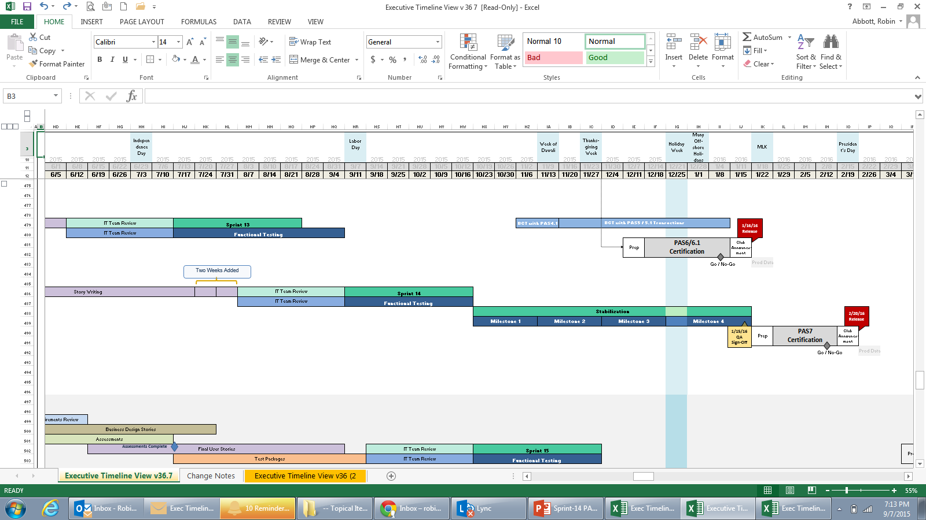
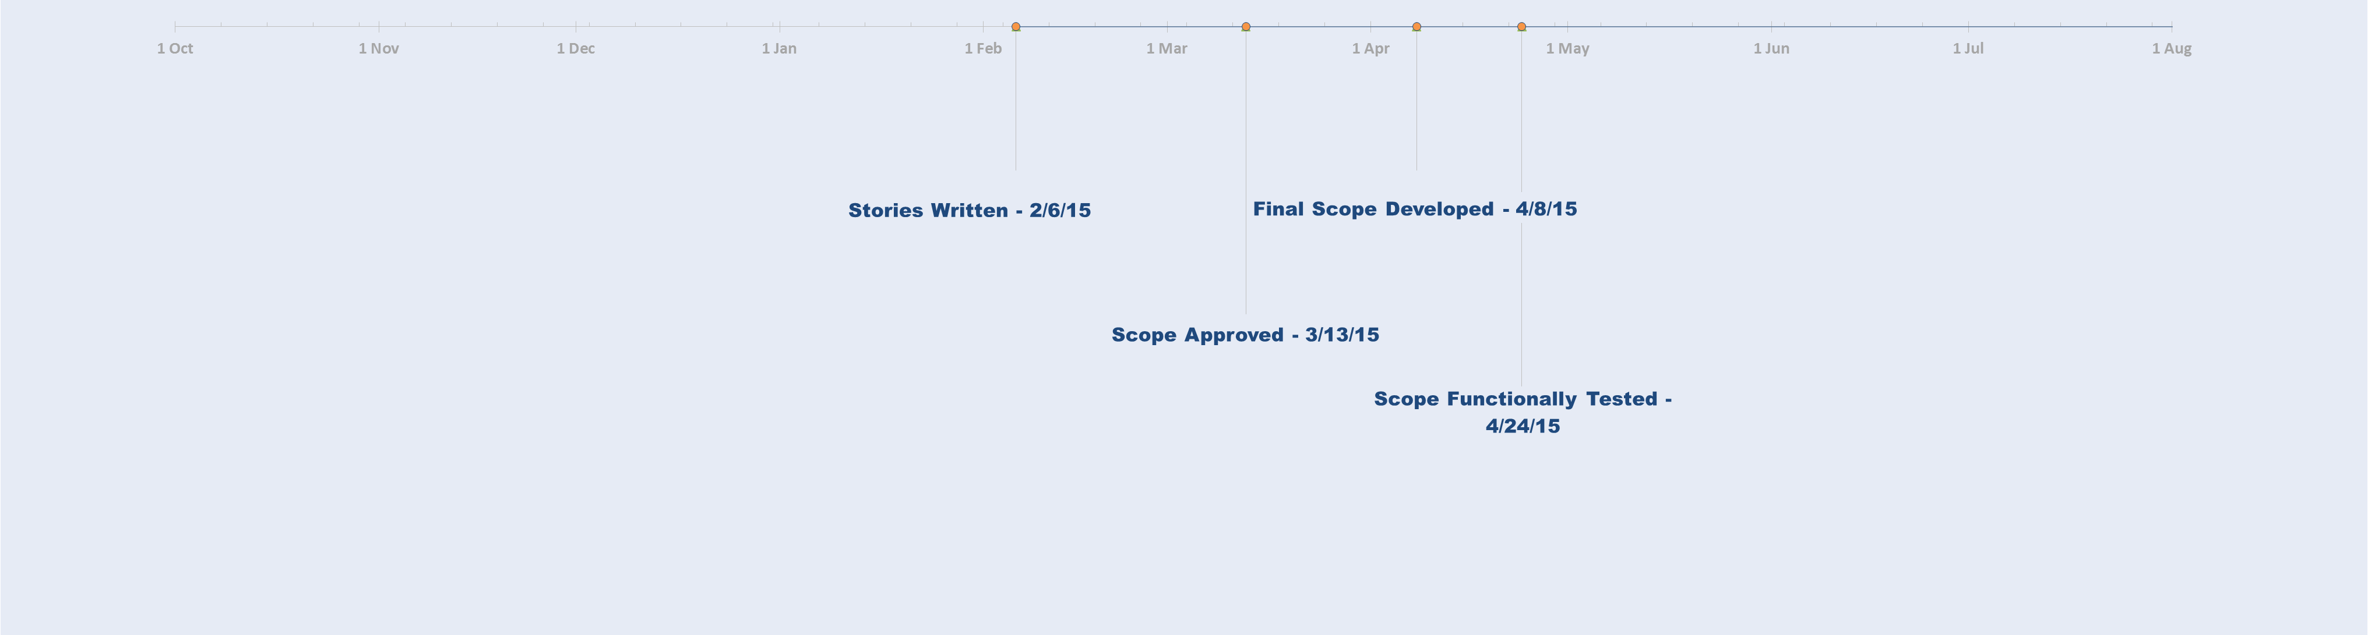
2.0 Scope Control
We Are Here
Change Requests (including impact assessments) are now required for any change to the scope.
In the past, administrative CRs were required prior to IT Team Reviews, but now they are not required until the beginning of the second sprint.
Program Director Approval
will be required
after the final feature build.
Historical Note: Two weeks were added prior to the start of Sprint 14 for story writing to assure capture of CA Select DOI and Manual Conversion stories into PAS7 scope.
Stories Written 7/31/15
Scope Approved 9/4/15
Final Scope Developed 10/2/15
Functional Execution Complete 10/16/15
Notes:
NOTE: After Final Feature Complete Build in the Second Sprint…
Scott Hunt will need to approve any Change Requests

Slide 6
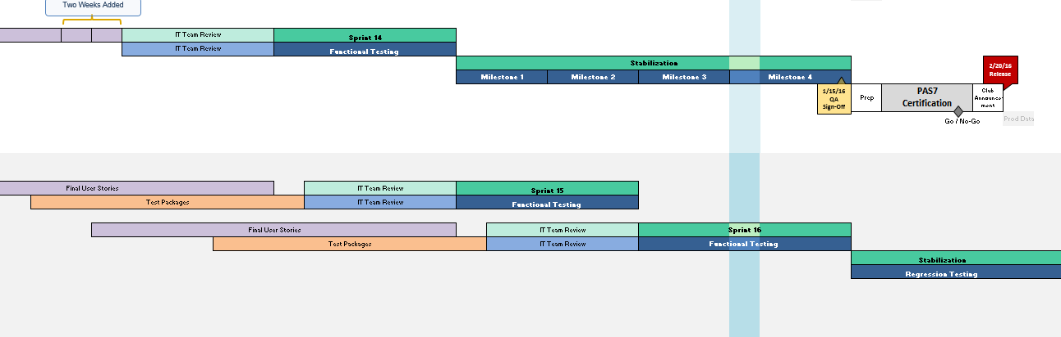
3.0 Sprint Parameters
Timeframe
6-week cadence:
from today, Monday 9/7/15 to Friday, 10/16/15
Group Deliveries
Group delivery numbers can still be used as an indicator of when items can be expected, but not as a hard commitment
The Agile methodology should naturally drive timely Dev delivery and QA testing of planned functionality
Sprint 15 IT Team Review *
IT Team Review for the next sprint will also take place during the Sprint 14 timeframe
ITTR remains the customary 5 weeks, and begins one week into Sprint 14 (i.e. 9/14/15)
Sprint 15 User Stories Completed 9/4/15
Sprint 15 Test Packages Completed 9/11/15
IT Team Review Begins 9/14/15
IT Team Review Complete 10/16/15
Notes:
NOTE: After Final Feature Complete Build in the Second Sprint…
Scott Hunt will need to approve any Change Requests

Slide 7
4.0 Key Checkpoints for the Sprint
The latest version of the PAS7 Executive Timeline View can be found on SharePoint:
Link to the Executive Timeline View
http://aaagateway/sites/PASFactory/Oversight/_layouts/15/start.aspx#/Shared%20Documents/Forms/AllItems.aspx?View=%7B29E0DD2C%2D979B%2D4717%2DA5A3%2D0CD7AC2EA2A4%7D
Feature Development Complete
New Feature Development Should Be
100% by This Date (for scope defined at kick-off)
Monday Morning
10/5/2015 // 7:00 AM (AZ Time)
100% Functional Tests Run
Functional Test Execution Should Be
100% Complete (for scope defined at kick-off)
Friday Evening
10/16/2015 // 5:00 PM (AZ Time)
Feature Development Complete
New Feature Development Should Be
100% by This Date (for scope defined at kick-off)
Wednesday Morning
2/25/2015 // 7:00 AM (AZ Time)
100% Functional Tests Run
Functional Test Execution Should Be
100% Complete (for scope defined at kick-off)
Monday Morning
3/9/2014 // 7:00 AM (AZ Time)
Stories Written 7/31/15
Scope Approved 9/4/15
Final Scope Developed 10/2/15
Functional Execution Complete 10/16/15
Notes:
NOTE: After Final Feature Complete Build in the Second Sprint…
Scott Hunt will need to approve any Change Requests

Slide 8
5.0 Integrations Scope
Integrations Scope for PAS7 – Sprint 14
A) ETL Development and Testing for Conversion Cross Reference Feed
B) Support End Point Test Execution for the CA Select Rate Change and CA Choice implementation
Stories Written 7/31/15
Scope Approved 9/4/15
Final Scope Developed 10/2/15
Functional Execution Complete 10/16/15
Notes:
NOTE: After Final Feature Complete Build in the Second Sprint…
Scott Hunt will need to approve any Change Requests

Slide 9
6.0 Stabilization Parameters
Regression
Will run from 10/19/15 to 1/15/16, or 13 Weeks (there is one extra week in this release to account for a holiday week)
Traditional QA Milestones
QA will confirm the Merge Freeze and Golden Build dates prior to the start of regression testing
Milestone 4 Entrance Criteria:
100% “QA Approved”: All functional scope for the release has no outstanding defects against it
Golden Build: The build the Software Factory submits as ready for a production release
(i.e., requires no further code changes)
Traditional Exit Criteria for Stabilization (may be subject to change based on increased focus on quality):
100% of planned regression cycles have been executed, AND
100% of the Critical and High functional and regression defects are remediated
NOTE:
The traditional QA milestones below are subject to change by the QA Team
The final schedule will be shared prior to Stabilization start
Regression Testing Begins 10/19/15
QA Sign-Off 1/15/16
Notes:
NOTE: After Final Feature Complete Build in the Second Sprint…
Scott Hunt will need to approve any Change Requests

Slide 10
7.0 Impacts to the Schedule
7.1 Holidays to Plan Around: Sprint 14
During Sprint: From September 7th through October 16th
09/ 16 /15 thru 9/ 17 /15: Ganesh Choturthi: India Holiday
10/ 01 /15 thru 10/ 02 /15: Gandhi Jayanti: India Holiday
10/ 01 /15 thru 10/ 07 /15: Suzhou Holiday
7.2 Holidays to Plan Around: Stabilization
During Regression: From October 19th through January 15th
10/ 21 /15 thru 10/ 20 /15: Ayudha Puja: India Holiday
11/ 04 /15: St. Petersburg Holiday
11/ 10 /15: Diwali / Kali Puja
11/ 26 /15: Thanksgiving Day: U.S. *
11/ 27 /15: Day After Thanksgiving: U.S. *
11/ 18 /15: Riga Holiday
12/ 24 /15: Riga, Vilnius Holiday
12/ 25 /15: Christmas: U.S., Minsk, Vilnius, India Holiday
12/ 31 /15: Riga Holiday
01/ 01 /15: New Year’s Day: U.S., India
01/ 05 /15: New Year’s Day: Pongal, Tamil
* Most likely to affect onshore resources
Notes:
From: M, Vijay Krishna Sent: Monday, January 12, 2015 4:02 PM To: Barron, Jennifer Cc: Jaganath, Rangachari Subject: RE: Offshore Holidays in January for QA Team?
Jen,
This plan is not applicable for QA team. We didn’t go with this plan due to amount of test cases that will be delivered on Group 4 (1/14) that has to be completed by end of sprint.
There is 2 regular offshore holidays one on 1/15 (this Thursday) and another on 1/26 where the team will not be available. We have included these 2 holidays in our sprint 9 and sprint 10 capacity plan already.
Thanks
Vijay Krishna
Office: 602-547-6049
Cell: 443-823-6418

Slide 11
7.0 Impacts to the Schedule
7.3 Environments and Other Maintenance Dates
 | Description | Date | Start/End Time | Duration
Sprint 14 | Patching Maintenance Window | 9/11/15 | 1p / 5p | 4 hours
 | Patching Maintenance Window | 9/25/15 | 1p / 5p | 4 hours
 | Patching Maintenance Window | 10/9/15 | 1p / 5p | 4 hours
Regression | MS Patching PeopleSoft Window | 10/17/15 | 10a / 12p | 2 hours
 | MS Patching PeopleSoft Window | 10/18/15 | 10a / 12p | 2 hours
 | Patching Maintenance Window | 11/6/15 | 1p / 5p | 4 hours
 | Patching Maintenance Window | 11/20/15 | 1p / 5p | 4 hours
 | Patching Maintenance Window | 12/4/15 | 1p / 5p | 4 hours
 | Patching Maintenance Window | 12/18/15 | 1p / 5p | 4 hours
 | Patching Maintenance Window | 1/1/15 | 1p / 5p | 4 hours
 | Patching Maintenance Window | 1/15/16 | 1p / 5p | 4 hours
Above are the Environments patching activities tentatively scheduled during this Sprint.
These dates may change if any emergency patches be required.
The implementers for these changes don't have offshore teams, and typically work onsite during onshore hours; there should be little-to-no downtime impact to our offshore teams, but there could be some impact to our onshore teams.
For more information on Non-Production Infrastructure Maintenance, go to the schedule located here:
Environments Management Calendar
http://aaagateway/sites/EnvironmentManagement/infra/SitePages/Home.aspx

Slide 12
Appendix: Scope List
Group Deliveries are captured within the above embedded spreadsheet.
See “Priority Group” on the
“AND_PAS7 Final Scope Actuals” tab,
column AA.
Any items labeled with “None” will likely be delivered in Group 4, unless otherwise stated.

